Slide 1

Department of Computer Science and Engineering
(Cyber Security)
CS23533– Foundations of Artificial Intelligence
2026-2027
ADVERSARIAL STATE-SPACE OPTIMIZATION
IN CHESS ENVIRONMENTS | MODEL REVIEW
Supervisor: Dr. S. Bhuvana
Assistant Professor (SG)
Team members:
Baviri Setty Sai Deevan (241901016)
Monish Priyan M (241901057)

Slide 2
Problem Statement and Motivation
▪
Chess has an enormous search space. Exhaustive Minimax is impractical at useful depths, especially under a move clock.
▪
Unstable positions create a horizon effect: stopping halfway through captures can make an unsafe move look attractive.
▪
Existing engines can be powerful but often depend on learned evaluation or hide how pruning and caching influence each decision.
▪
Our goal is a self-built, explainable classical-AI chess engine that plays legally, searches efficiently, and shows its work.

Slide 3
Objectives
▪
Formulate chess using AI state-space concepts: legal actions, state transitions, terminal states and a rational adversary.
▪
Implement the board, rules and five-part evaluation function from scratch, without ML, external chess libraries or datasets.
▪
Build efficient, time-aware search using Negamax, Alpha-Beta, iterative deepening, quiescence, move ordering and a fixed transposition table.
▪
Demonstrate and validate the system. Achieved: 7 / 7 standard perft sets, 53 automated tests and 79 / 79 exact-search comparisons.

Slide 4
Abstract
▪
Chess is a fully observable, deterministic, zero-sum game. Our agent searches future moves to choose a response.
▪
The custom rules engine generates legal moves, while five hand-crafted terms evaluate each position.
▪
Negamax and Alpha-Beta combine with iterative deepening, quiescence, move ordering, hashing and null-move pruning.
▪
The browser displays moves, depth, nodes and scores. Perft, automated tests and matches validate the engine.

Slide 5
Literature Survey
No. | Author(s), Year | Paper Title | Method / Algorithm | Limitations
1 | Shannon (1950) | Programming a Computer for Playing Chess | Minimax + static evaluation | Full-width trees grow exponentially
2 | Zobrist (1970) | A New Hashing Method with Application for Game Playing | XOR-based position keys | Collisions; bounded storage needed
3 | Knuth & Moore (1975) | An Analysis of Alpha-Beta Pruning | Formal Alpha-Beta analysis | Benefit depends on move ordering
Sources and limitations adapted from Phase I Report, literature review (Table 2.1).

Slide 6
Literature Survey
No. | Author(s), Year | Paper Title | Method / Algorithm | Limitations
4 | Beal (1990) | A Generalised Quiescence Search Algorithm | Selective search of tactical leaves | Extra search effort; checks remain a challenge
5 | Donninger (1993) | Null Move and Deep Search | Reduced-depth null-move pruning | Can fail in zugzwang and tactical traps
These studies motivate quiescence search and guarded null-move pruning in our engine.

Slide 7
Research Gap/Existing System
1. Existing studies
Minimax searches against the opponent; Alpha-Beta, move ordering, hashing and selective search reduce effort.
2. Limitations observed
Game trees remain huge; horizon errors persist. Neural engines and library-based demos do not isolate every decision.
3. Research gap
Few classroom engines combine from-scratch rule validation, comparable search variants and an accessible explanation of search cost.
4. Our response
We built a verified classical engine with teaching-mode comparisons, real-time telemetry and browser-based deployment.

Slide 8
Proposed System
React interface
Web Worker
Search engine
Move result
Board, clocks, SAN, FEN, teaching mode
Runs search off the UI thread
Iterative deepening + Negamax / Alpha-Beta
Best move, score, depth and nodes
Move generator
Heuristic evaluation
Search optimisation
Verification & CI
Legal actions; make / unmake
5 interpretable terms
MVV-LVA, QS, null move, TT
Perft, node:test, Actions
All core game logic is self-written. The browser uses HTTPS static assets; no gameplay server or training data.

Slide 9
DFD Diagram
PLAYER
P1 · REACT UI
P2 · ENGINE WORKER
OUTPUT
Click, type SAN/UCI, choose FEN
Input, rules feedback, display
Legal moves → search → score
Board move + live telemetry
D1 · GAME STATE
D2 · SEARCH CACHE
Position, clocks, repetition history
Zobrist-hashed fixed-size table
Level 1 DFD · User requests a move; the worker reads board state and search cache, then returns a legal move and metrics.

Slide 10
Methodology/Work Flow Diagram
01 · INPUT
02 · VALIDATE
03 · SEARCH
04 · OPTIMISE
05 · OUTPUT
Player move / FEN
Rules, legality, FEN
Negamax + α-β + ID
QS, TT, ordering, null move
Move + depth + score
BUILD / TEST
BENCHMARK
DEPLOY
Node test suite → perft validation
17 positions; self-play; Stockfish
GitHub Actions → Firebase HTTPS
No dataset training or preprocessing is required; chess positions are rules-based test inputs.

Slide 11
Tools and Technologies
▪
Language and engine: JavaScript (ES modules), a custom 64-square board model and self-written search algorithms.
▪
Interface: React 19, Vite 8, CSS and the Web Workers API. Search runs without blocking the chessboard.
▪
Validation: Node.js 20 with node:test (53 cases), published perft suites, benchmarking scripts and Stockfish 19 as reference only.
▪
Delivery: Git/GitHub, GitHub Actions and Firebase Hosting. No GPU, external chess library or ML dataset is required.

Slide 12
List of Modules
M1
Board and move generation
✓ Completed
M2
Five-term evaluation
✓ Completed
M3
Adversarial search
✓ Completed
M4
Search optimisation
✓ Completed
M5
UI, teaching mode and deployment
✓ Completed
M6
Verification and benchmarks
✓ Completed
All six modules are implemented. The next slides give a separate description of each module.

Slide 13
Module Descriptions · 1–3
M1
Board Representation & Move Generation
64-square board; legal move checks; castling, en passant and promotion; FEN and SAN support.
M2
Hand-Crafted Heuristic Evaluation
Material, piece-square tables, pawn structure, king safety and mobility produce a centipawn score.
M3
Adversarial Search Engine
Iterative deepening runs Negamax with Alpha-Beta inside a move-time budget and returns the best move.
All components are self-built and run locally in the browser; no learned chess model is used.

Slide 14
Module Descriptions · 4–6
M4
Search Optimization
MVV-LVA ordering, quiescence, null-move pruning and a fixed 10 MB Zobrist transposition table.
M5
User Interface & Deployment
React play screen, game clocks, legal hints, SAN input, premoves, teaching mode and Firebase Hosting.
M6
Testing & Benchmarking
Node.js test suite, perft correctness, controlled search comparisons and self-play/Stockfish games.
The engine works in a Web Worker, keeping the chess interface responsive during searches.

Slide 15
Results & Discussion
Starting position · fixed depth 5
Plain Minimax
Alpha-Beta
Alpha-Beta + ordering + TT
5,072,213
113,360
58,390
baseline · 15.0 s
45× fewer nodes · 0.42 s
87× fewer nodes · 0.28 s
110.6×
79 / 79
~1600–1700
mean depth-4 saving on 17 positions
exact-search agreement with Minimax
Stockfish calibrated scale · 1 s / move
53 automated tests · 7/7 standard perft positions · 128 Stockfish benchmark games. Results from Phase I Report.

Slide 16
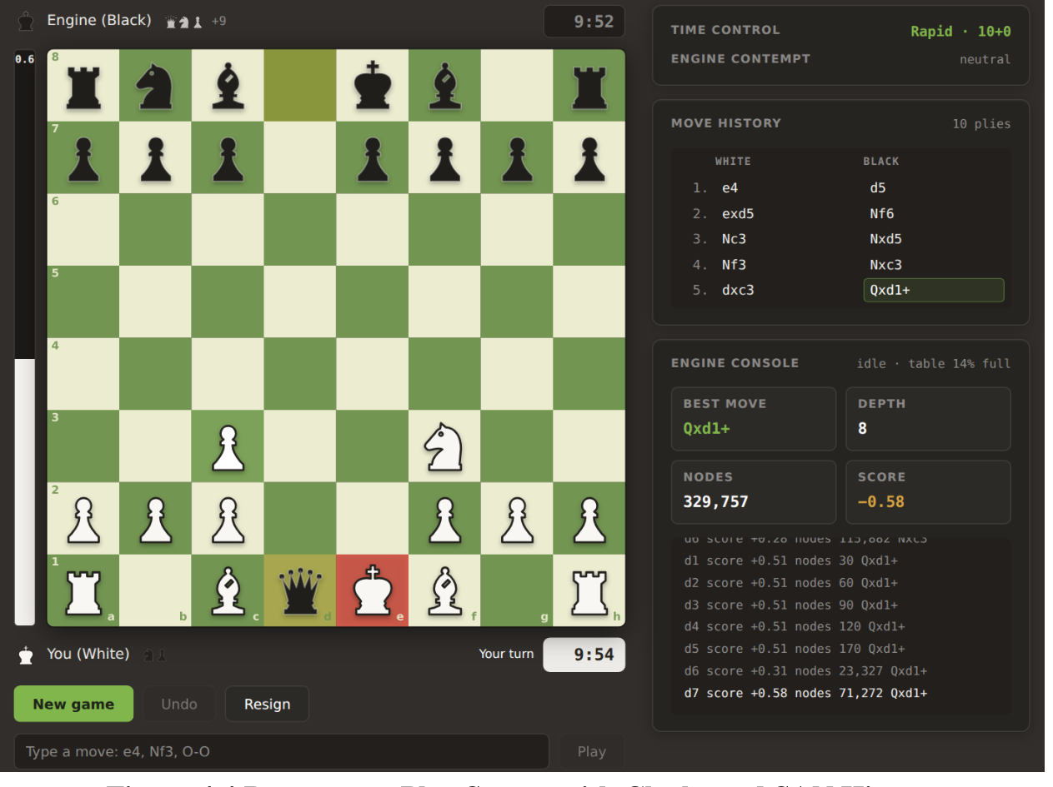
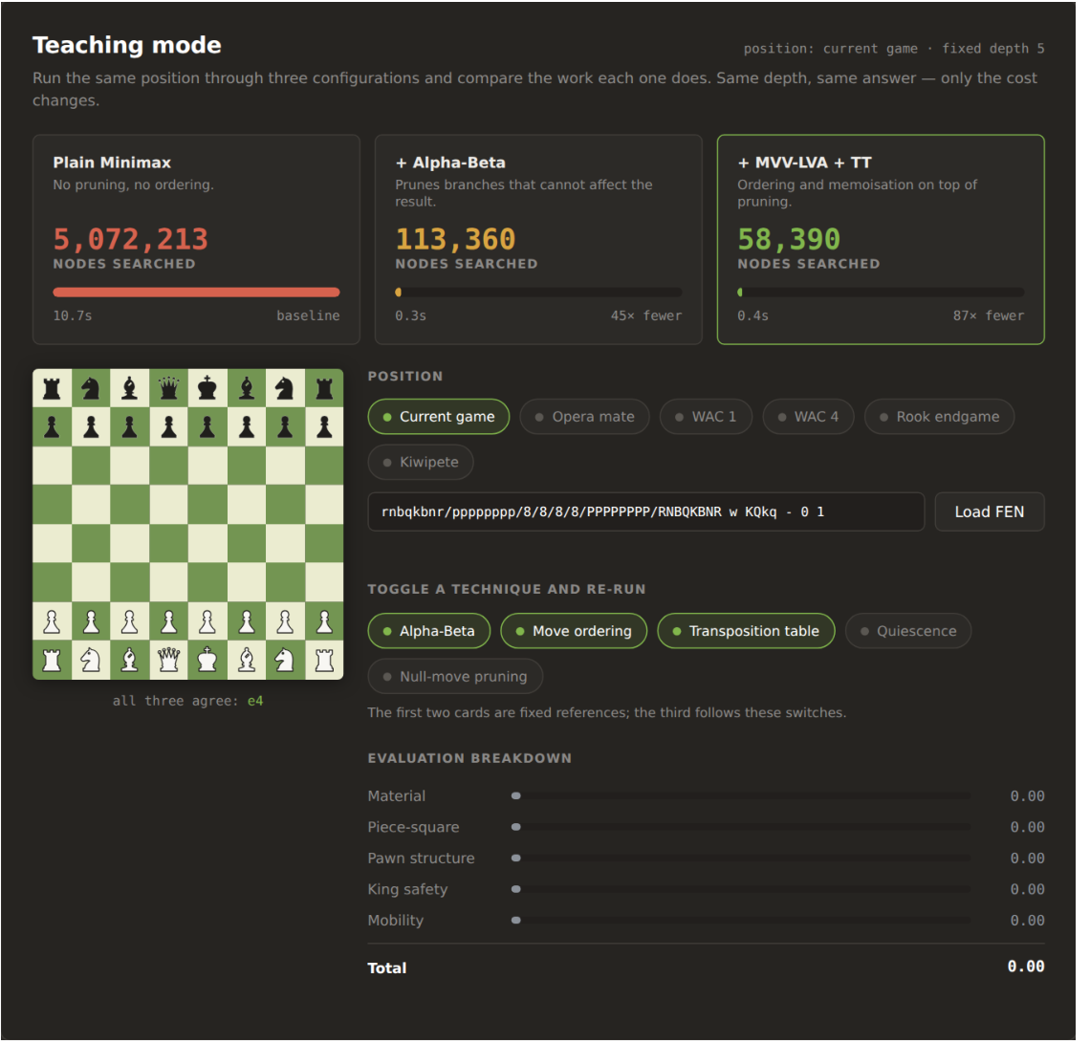
User Interface/ Screenshots
Play screen: clocks, SAN history and engine telemetry
Teaching mode: side-by-side search costs and FEN presets

Slide 17
Conclusion
▪
The project demonstrates a complete, explainable chess agent built only with classical AI search, heuristic evaluation and game-state reasoning.
▪
Correctness is independently supported by seven standard perft test positions and 53 automated tests.
▪
The optimised exact-search variants matched plain Minimax on all 79 comparable searches while greatly reducing explored nodes.
▪
The React app makes the results accessible through interactive gameplay, teaching-mode comparisons and live engine telemetry.

Slide 18
Future Work
▪
Improve tactical stability by adding check evasions and selective check extensions to the quiescence search.
▪
Explore killer/history move ordering and incremental Zobrist updates to improve search speed.
▪
Increase testing across opening styles, playing strengths, browsers and different move-time budgets.
▪
Harden CI/CD and Firebase delivery with scoped deployment permissions, security headers and dependency scanning.

Slide 19
References
[1] C. E. Shannon, “Programming a Computer for Playing Chess,” Philosophical Magazine, 1950.
[2] A. L. Zobrist, “A New Hashing Method with Application for Game Playing,” Tech. Rep. 88, 1970.
[3] D. E. Knuth and R. W. Moore, “An Analysis of Alpha-Beta Pruning,” Artificial Intelligence, 1975.
[4] D. F. Beal, “A Generalised Quiescence Search Algorithm,” Artificial Intelligence, 1990.
[5] C. Donninger, “Null Move and Deep Search,” ICCA Journal, 1993.
[6] S. Russell and P. Norvig, Artificial Intelligence: A Modern Approach, 4th ed., Pearson, 2020.
[7] SaIdEeVaN, FOAI-Project (source, benchmarks and REPORT.md), github.com/SaIdEeVaN/FOAI-Project.

Slide 20
Thank You
Adversarial State-Space Optimization in Chess Environments
Live demo: foai-chess-engine.web.app
Code and experiments: github.com/SaIdEeVaN/FOAI-Project

